Slide 1
Production & Deployment Report
Week 36: 6th Sep 2021-12th Sep 2021

Slide 2
Exec Summary
Week 36 Highlights
KP Accuracy/Regulatory
After 3 Month Verification by System Group Limited.
Calibrated 4 KPs out of 4 KPs - Newly deployed.
V 6.2 SDS Calibration and Validation
Deployment.
10 out of 12 inspections completed - 7 Pass, 3 Fail
4 out of 4 civil works done
0 distributions done
0 installations done
SDS V6.2 deployment and installation to Dandora site
Decommissioning & Service Requests
Decommissioned SDS-007(Dandora)
2 out of 2 decommissioning requests complete
Relocation of Refill box - Ahadi General shop and cereals
Production
KA32 - 20Pcs, KA16 - 50Pcs and KA7 - 28Pcs setup for NOC spares
STS 014 & 016 completed- Dome fittings
Mombasa hardware testing assemblies completed
STS-018 v6.2 24V Battery charger assembly completed
Maintenance
3 tickets: 1- Under dispensing, 1-1169 MS-BS discrepancy investigation . 1-Out of Service (Error 092)- 2 Closed, 1 Open.
Inventory
Return rate at 1%.
Received Poynting antennas - 17 Pcs
Ordered STS Methanol pump upgrade fittings
Week 37 Priorities
KP Accuracy/Regulatory
Calibration of newly deployed KPs.
After 3 Month Verification by System Group Limited.
Field tickets
Quality Control
Analysis and QC of defective and reworked items/Parts
KPs functionality QC
Incoming QC Items for KP, STS & SDS
Deployment
Shop Inspections -7 Shops
New agents civil works - 1 shop
KP distribution
Installation
Decommissioning & Service Requests
Poor performing KPs
Jefferies supermarket decommissioning due to Landlord-agent issues
Production
Defective items rework prioritizing KA35, KA30, KA46 and KA56
2H NOC spares
Prepare refill boxes cables and hoses for the new shops
Inventory
Receive parts for v6.2 STS and SDS and v6.1 KPs
Receive 2021 2H Orders

Slide 3
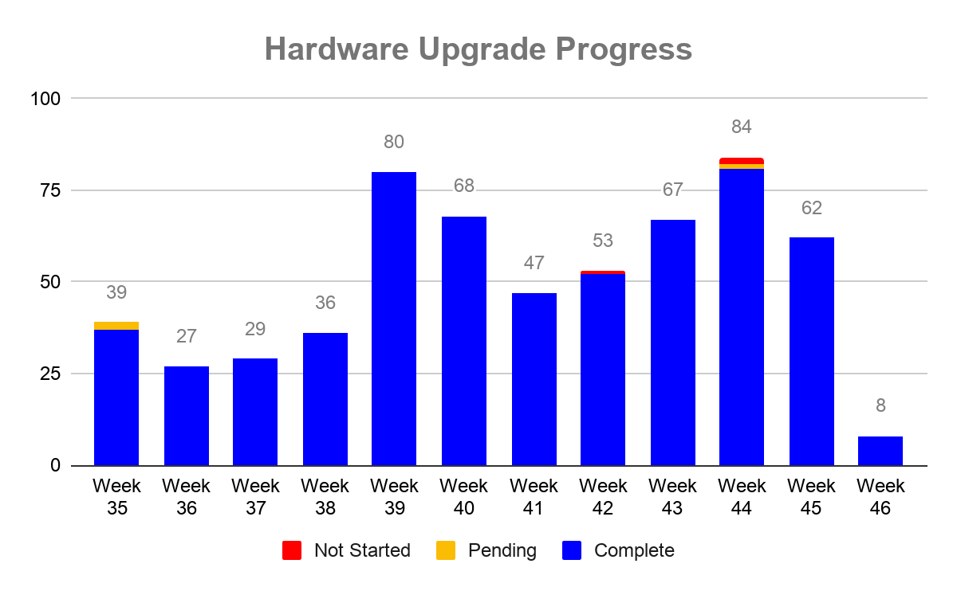
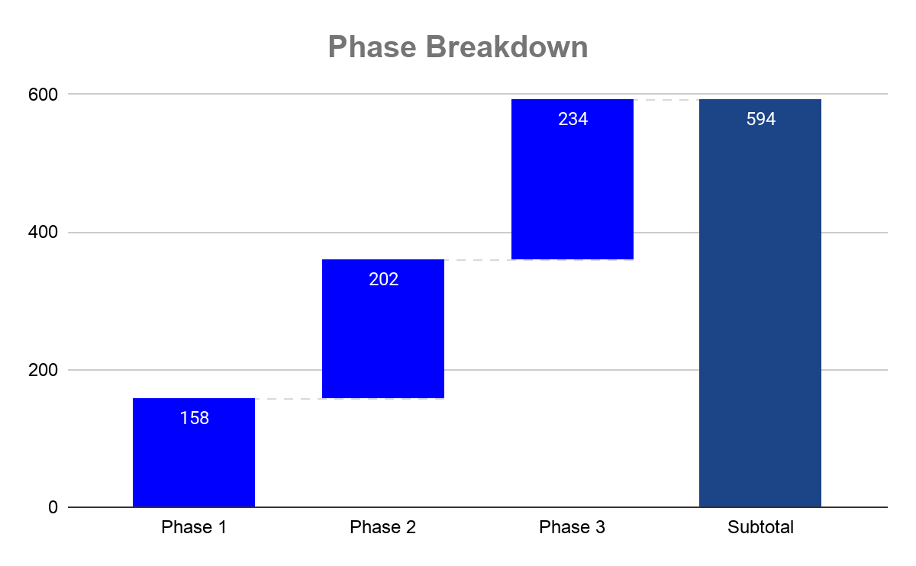
Deployment: Hardware Upgrade ^{[1,2]}
Shop Name | Neighborhood | Reason not Completed
Repzol Diesel Point Kiambu | Kiambu Township | Court Case
BEAUTIFLOW LTD | Kahawa West | Shop Always Closed
Naichu enterprises- pipeline | Pipeline | Poor Road
Wincla Computer College | Mathare North | Shop Always Closed
Notes:
Priority is always given to solving calibration related incidents when they occur
Pending status indicates 1 of the 4 hardware upgrade tasks was not completed due to one reason or the other

Slide 4
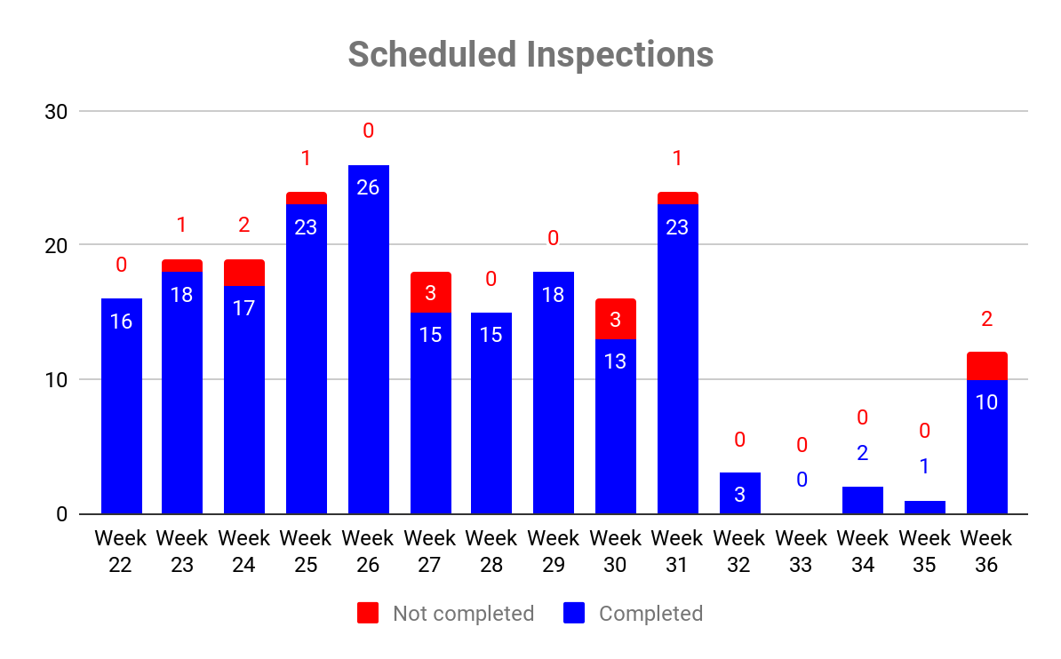
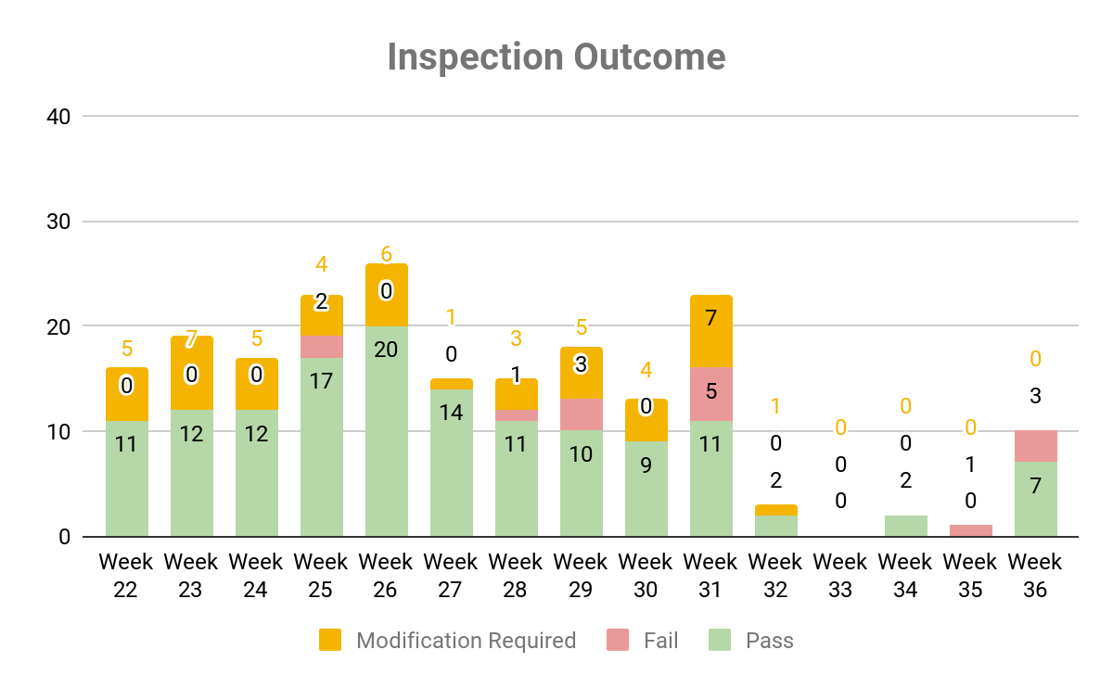
Deployment: Inspections ^{[3]}
Notes:
Shopify wholesale and retail - shop closed, Agent not picking calls
Pistan Investment - Agent not interested
Notes:
Modification required -Extensive shelf or grill cutting required to create KP space
Fails:
Texas electronics and gas suppliers - No space to create vent
Tatu Enterprises - No space to create vent
Wambui kerosene pump- No space to create vent

Slide 5
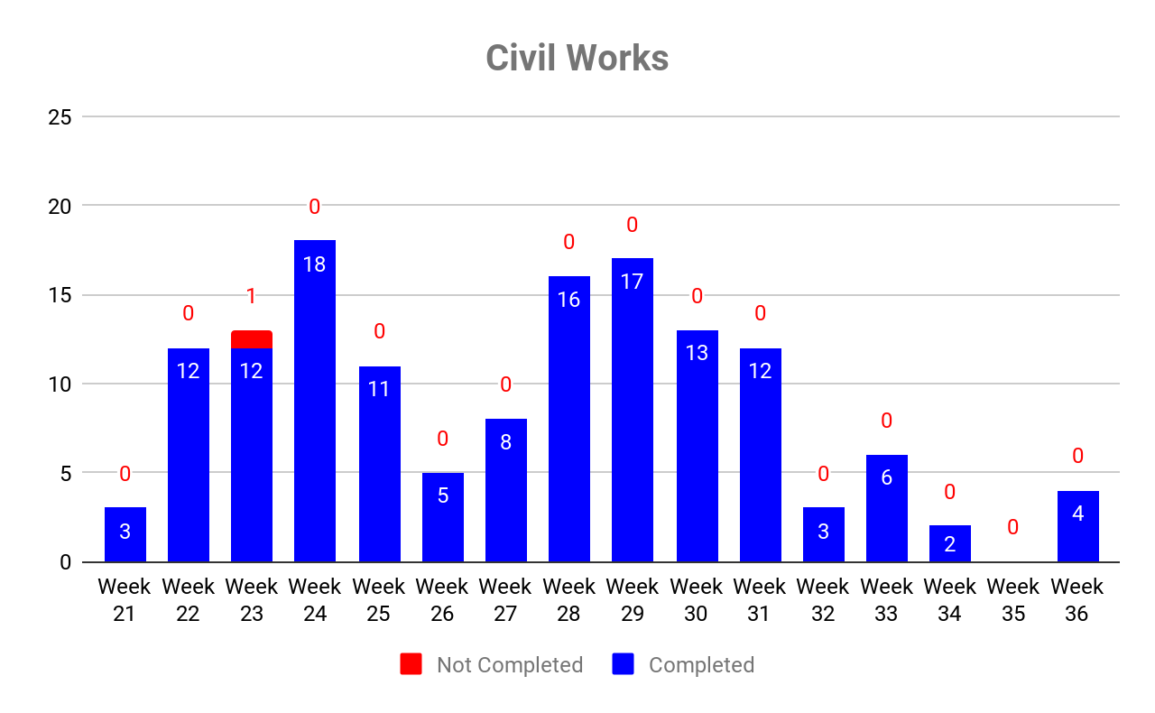
Deployment: Civil Works ^{[4]}
Notes:

Slide 6
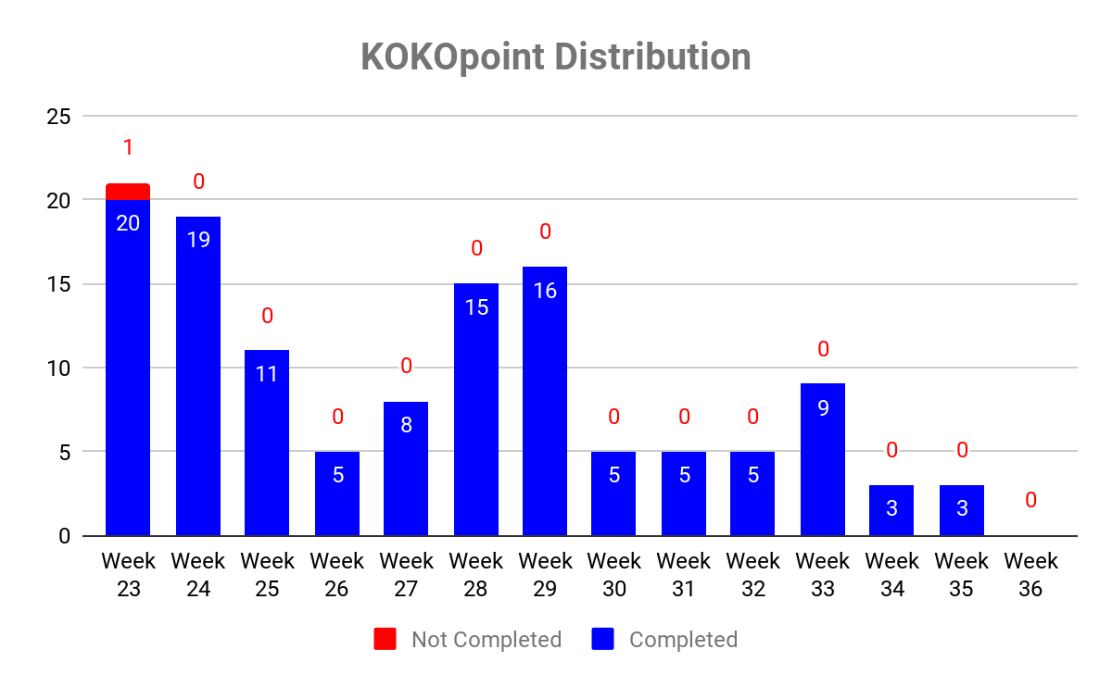
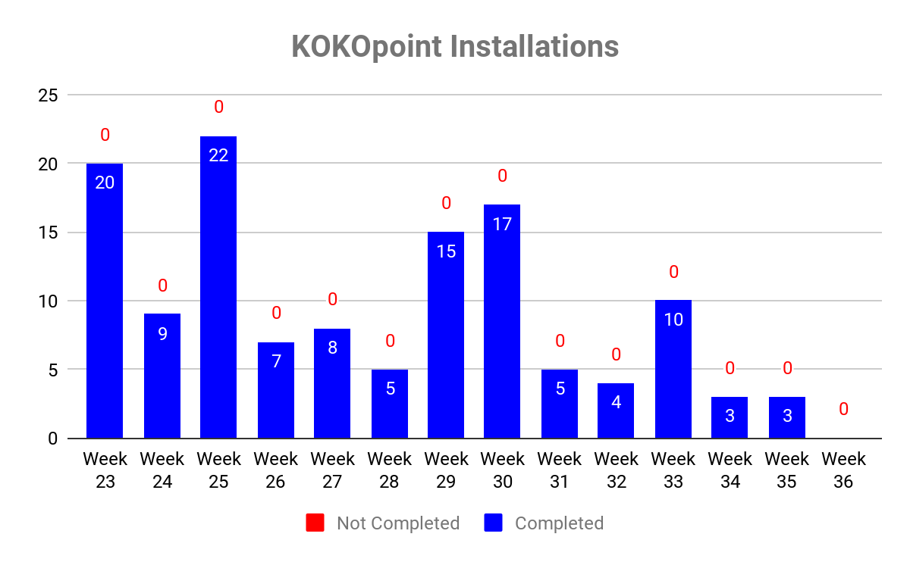
Deployment: Installations ^{[5]}
Distribution - Dropping off a KOKOpoint at agent location
Installation - Functionality tests to get the KOKOpoint ready for fueling and calibration
Notes:
Notes:

Slide 7
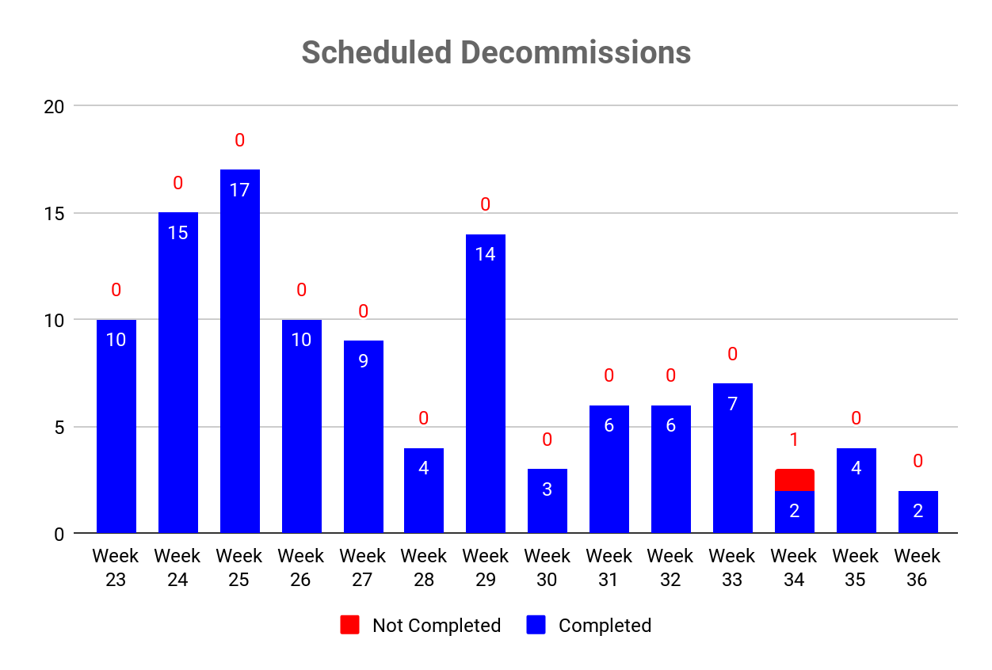
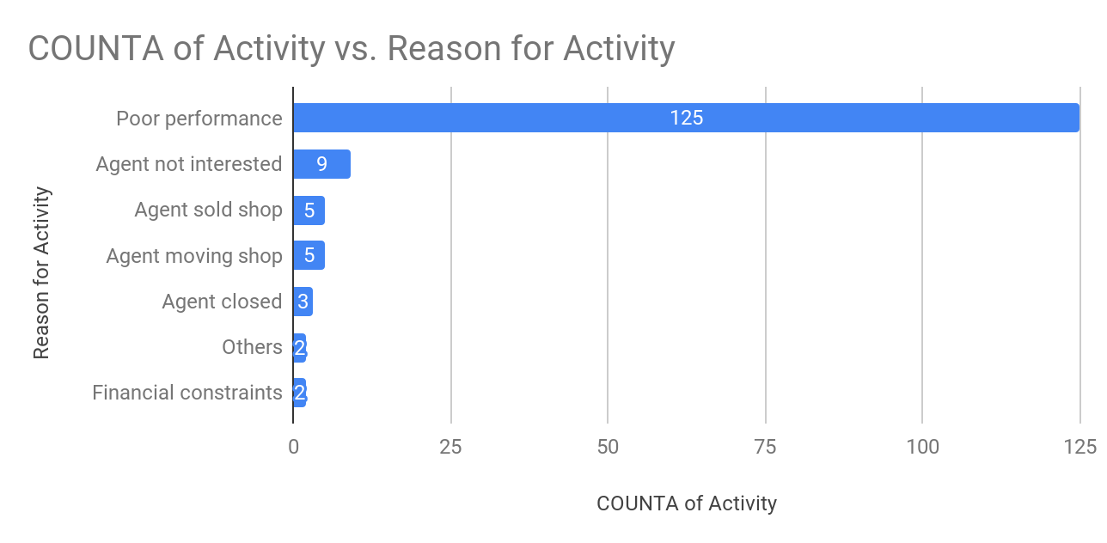
Deployment: Decommissioning ^{[6]}
Notes:

Slide 8
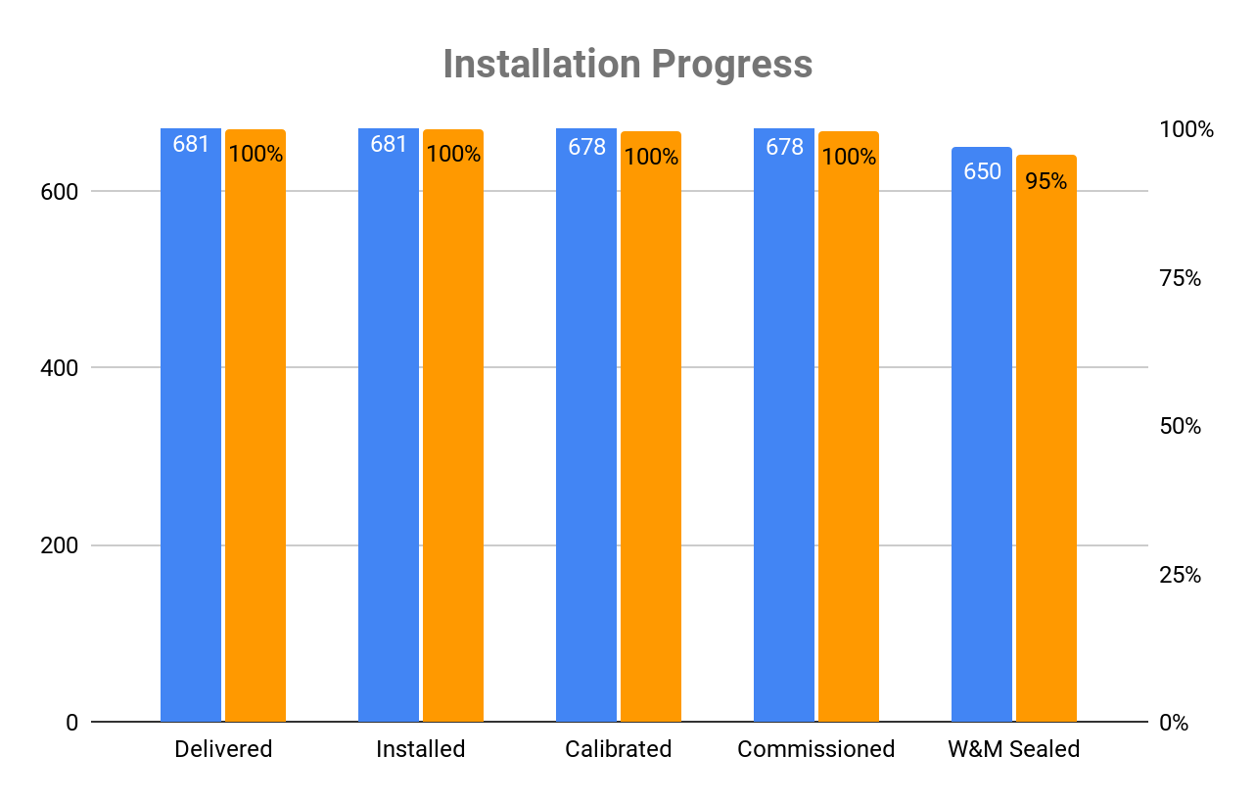
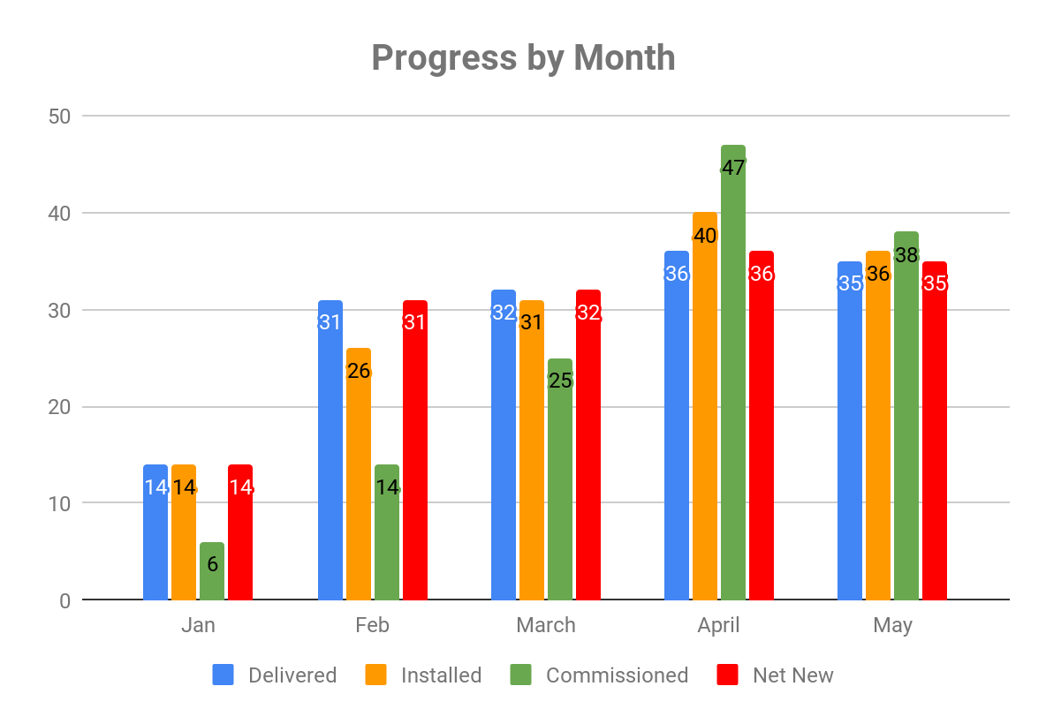
Deployment: Overall Status ^{[7]}
Notes:
Delivered KOKOpoints sitting in shops
Installed KOKOpoints installed and ready to be fueled
Calibrated Internal calibration by KOKO
SG Sealed KOKOpoints with calibration & seal from Systems Group Ltd
W&M Sealed KOKOpoints with calibration seal from W&M
Commissioned KOKOpoints ready for use by customers

Slide 9
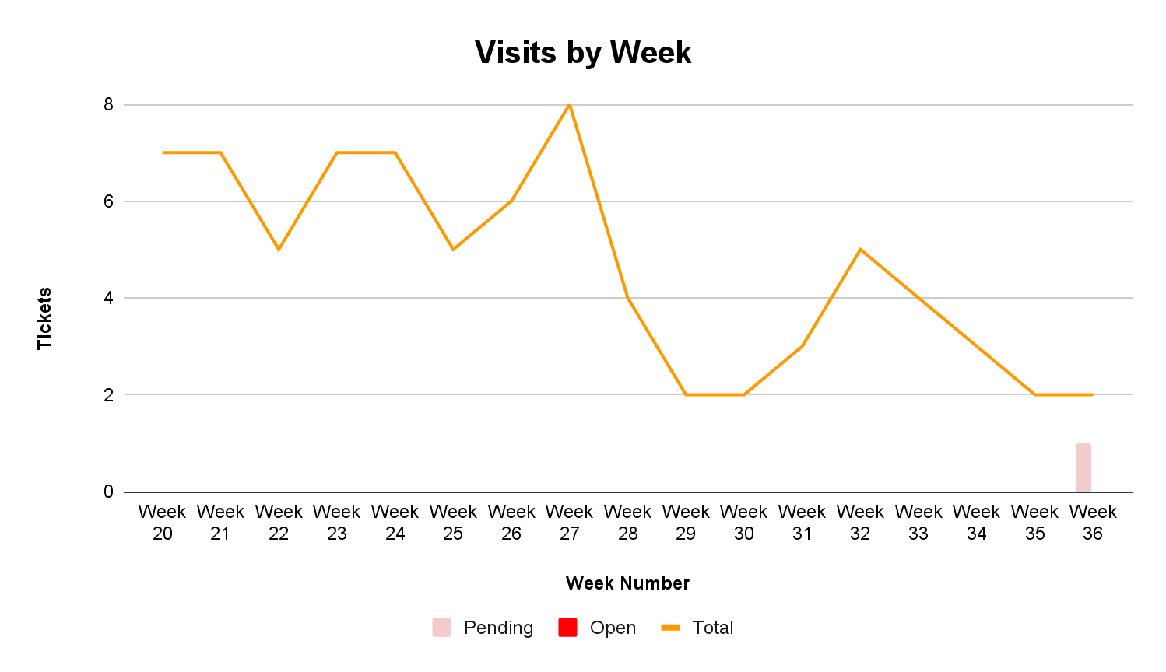
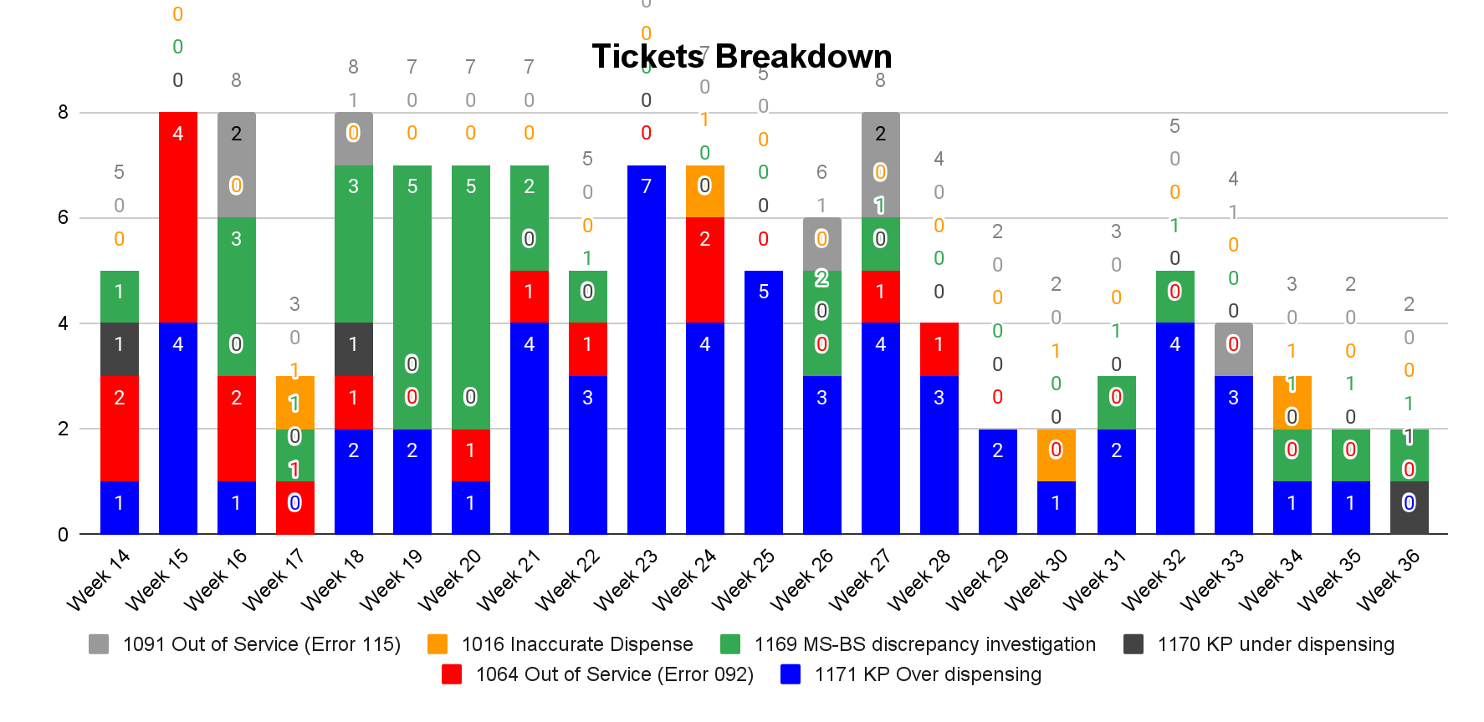
Calibration: Maintenance Tickets ^{[8]}
Notes:
Timko Agency 1 - Ticket allocated late

Slide 10
Calibration: Dispense Accuracy^{[9]}
Verification Reason | Shop Name | COUNTA of KP Serial No
High FMK | JOSPI CHEMIST | 1
 | Luzon (Kibera) | 1
 | Mama Bright Shop | 1
 | R and K | 1
 | Western general shop | 1
High FMK Total |  | 5
High Reported Tickets | Daughters Bookshop | 1
 | Ebenezer shop | 1
 | KOKOplex | 1
 | Muthurwa Nine Investments | 1
 | Neema cereals B. Dogo | 1
High Reported Tickets Total |  | 5
High Traffic | Arizona shop Dandora | 1
 | Danisora Investment Ltd (Umoja 2 and 3) | 1
 | Fair Price Cereals Shop | 1
 | Generali gas refill and electronics | 1
 | Hilnginga Tailoring Shop Kiambiu | 1
 | Kibsy traders | 1
 | Muhindi mweusi supermarket Chokaa | 1
 | Nevillos Investment | 1
 | Wamaina General Shop | 1
High Traffic Total |  | 9
Grand Total |  | 19
Notes
The new below left PCBs were installed in different KPs based on criteria highlighted below. The purpose of this test is to pilot the concept of supplying the KP flowmeter with 12V DC in a bid to reduce dispense inaccuracy cases.
Choice of the 19 KPs will be based on:
KPs which have high reported repeated cases of dispense inaccuracies in recent times (5 KPs). Purpose is to test if the 12V supply will reduce these dispense inaccuracy cases.
KPs whose FMK's are >3800 and <3100 (5KPs). Purpose is to test if these can be restored to the manufacturer's range and perform well.
KPs with high traffic (5 KPs). We will choose one of the 2 KPs installed at each of 5 busiest agent locations. Purpose is to observe general performance and any effect on the KP functionalities with frequent/accelerated use.
Testing and Data collection
Dispense accuracy verification for 0.3L, 0.5L, 1.0L and 2.0L volumes (total of 11 liters per test) after every two days till the end of the year led by Henry through the calibration team.
Tank level and flow rates during the test for analysis.
Test Report
A detailed test report shall be produced after every week and shared to the respective teams.

Slide 11
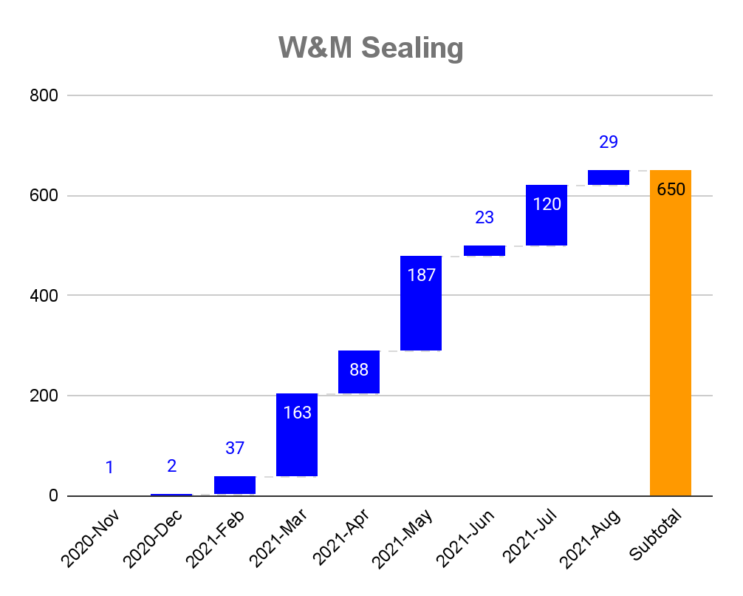
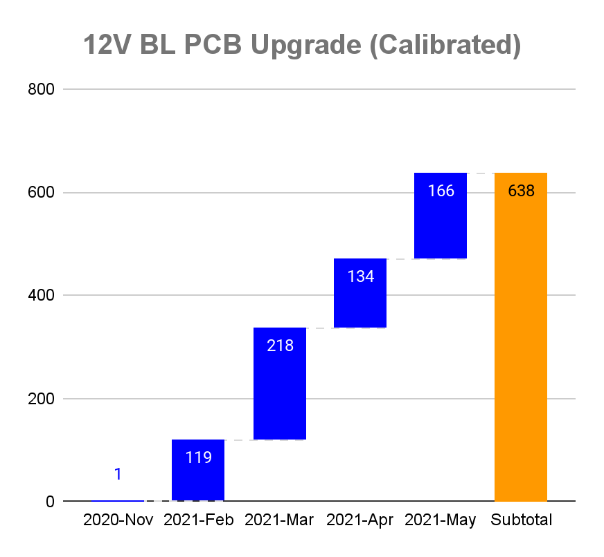
Calibration: W&M Sealing ^{[10]}
Notes:
W&M sealing progress at 96% (650/677)
Upgrade from 5V to 12V is the first to be done before verification. If a KP already has the 12V BL PCB, it goes straight to verification

Slide 12
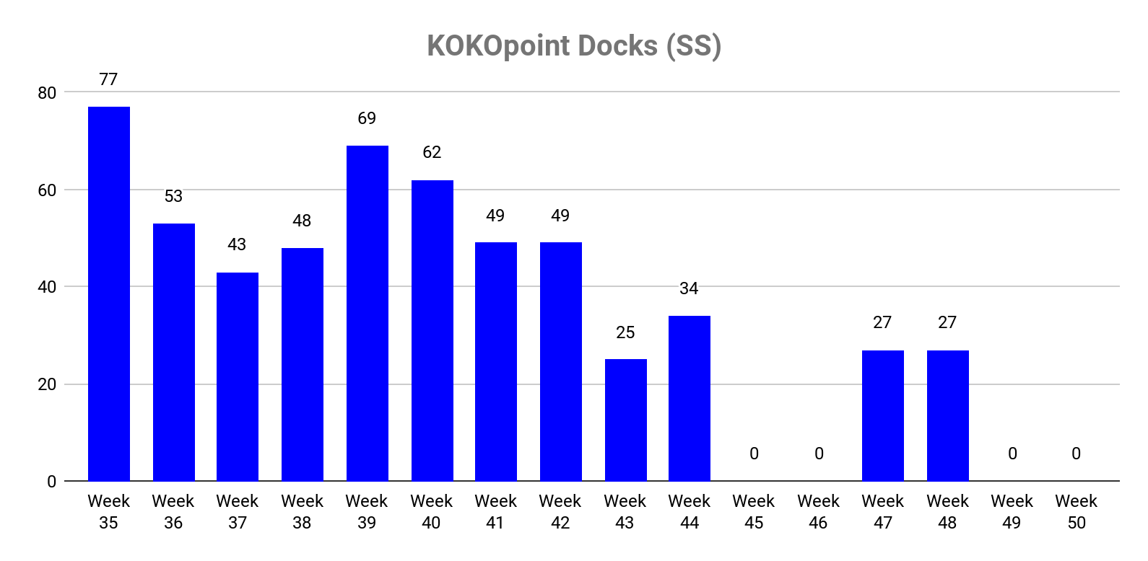
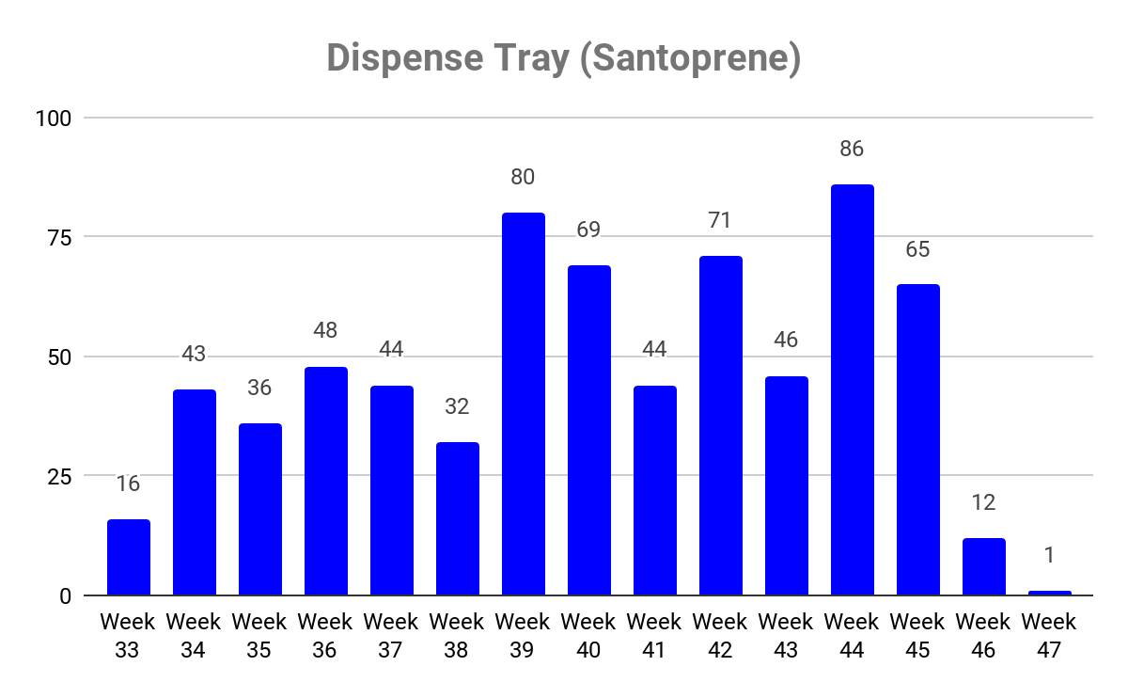
Production: Docks & Dispense Trays ^{[11]}
Notes:
No dispense tray assembled - Hardware upgrade complete
No docks assembled from batch 5(329 Parts)

Slide 13
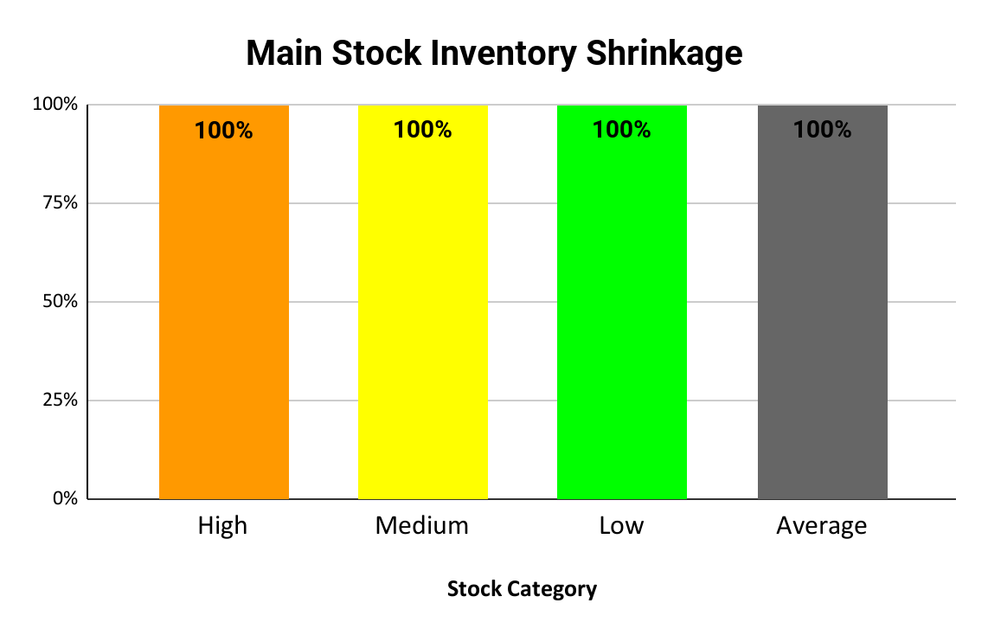
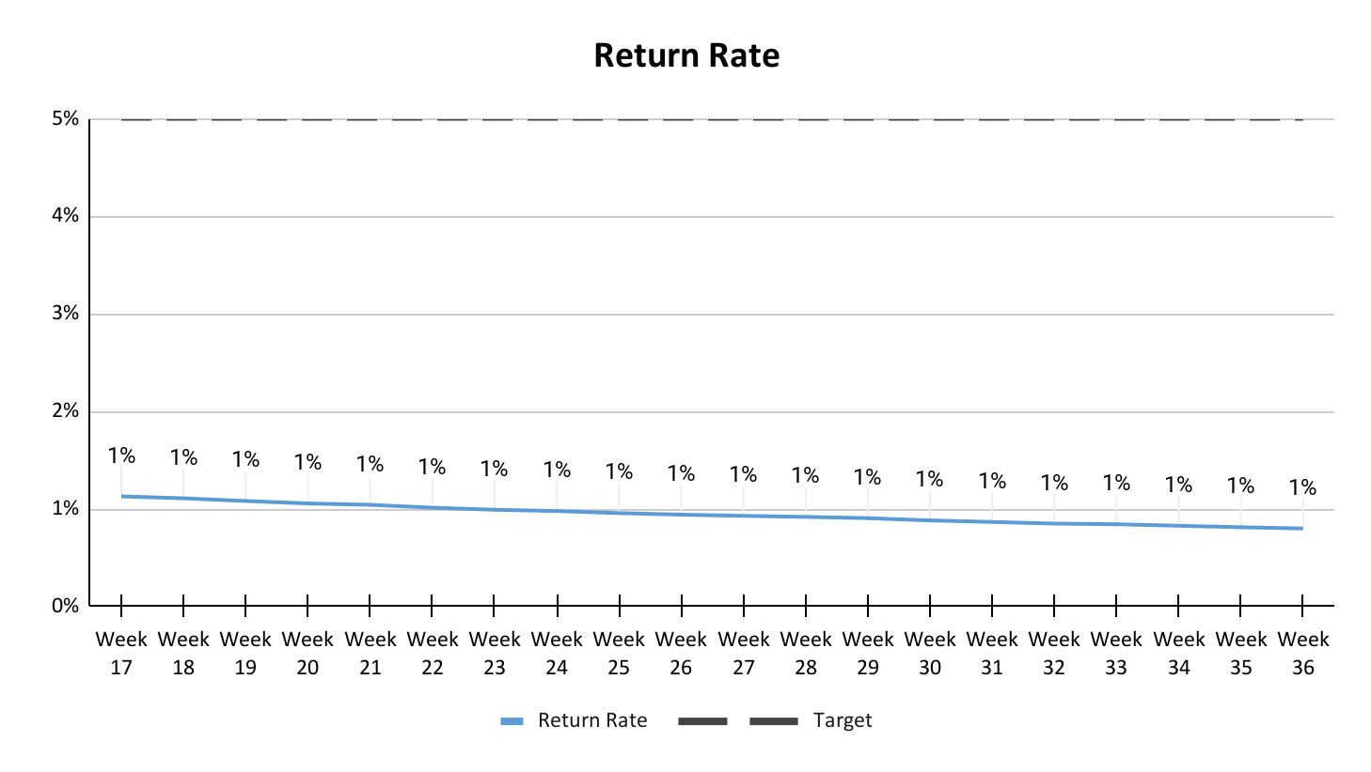
Store: Inventory ^{[12]}
Z | ZV | ZE | ZD
Y | YV | YE | YD
X | XV | XE | XD
 | V | E | D
X - Regular demand
Y - Strong variability in demand
Z - Very irregular & difficult to predict demand
V - Unavailability causes an immediate and unacceptable penalty
E - Unavailability induces a significant production/maintenance delay/significant financial penalty
D - Unavailability can be temporarily allowed without having a serious effect in operation

Slide 14
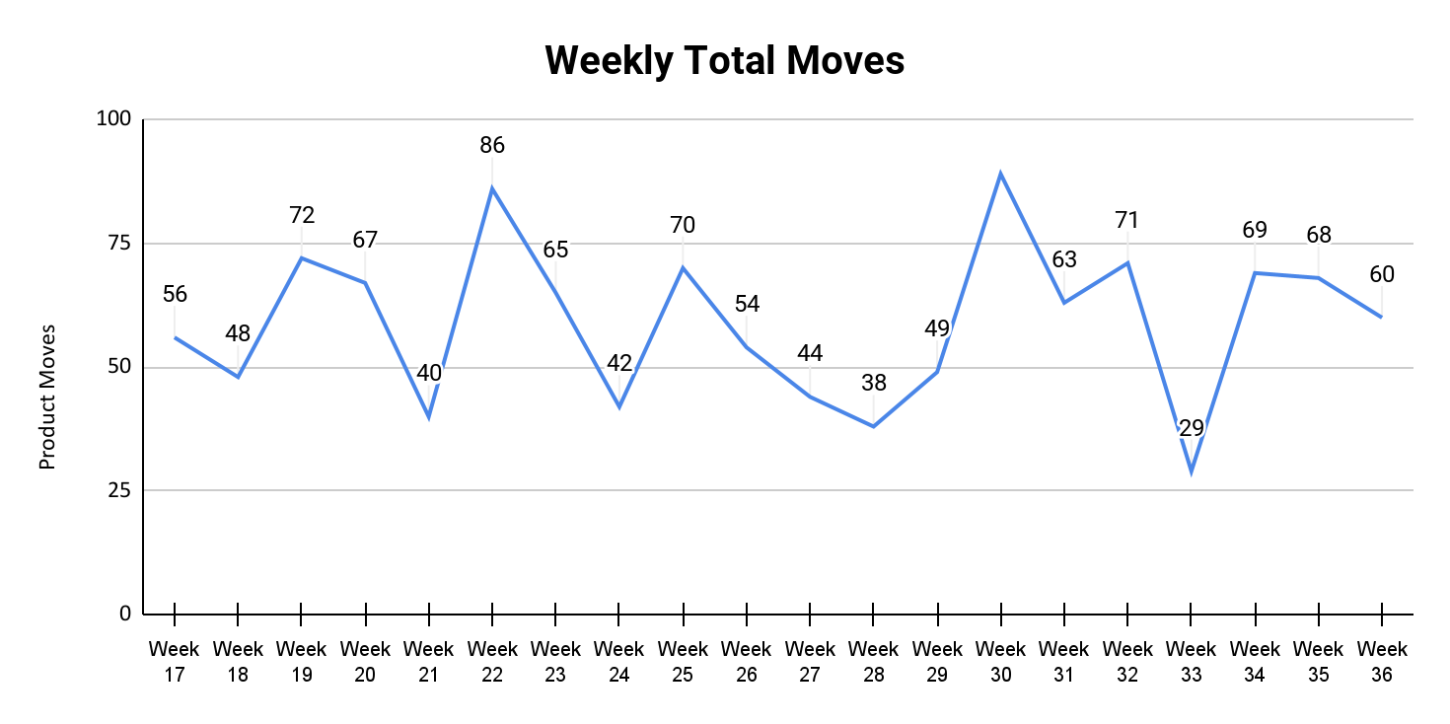
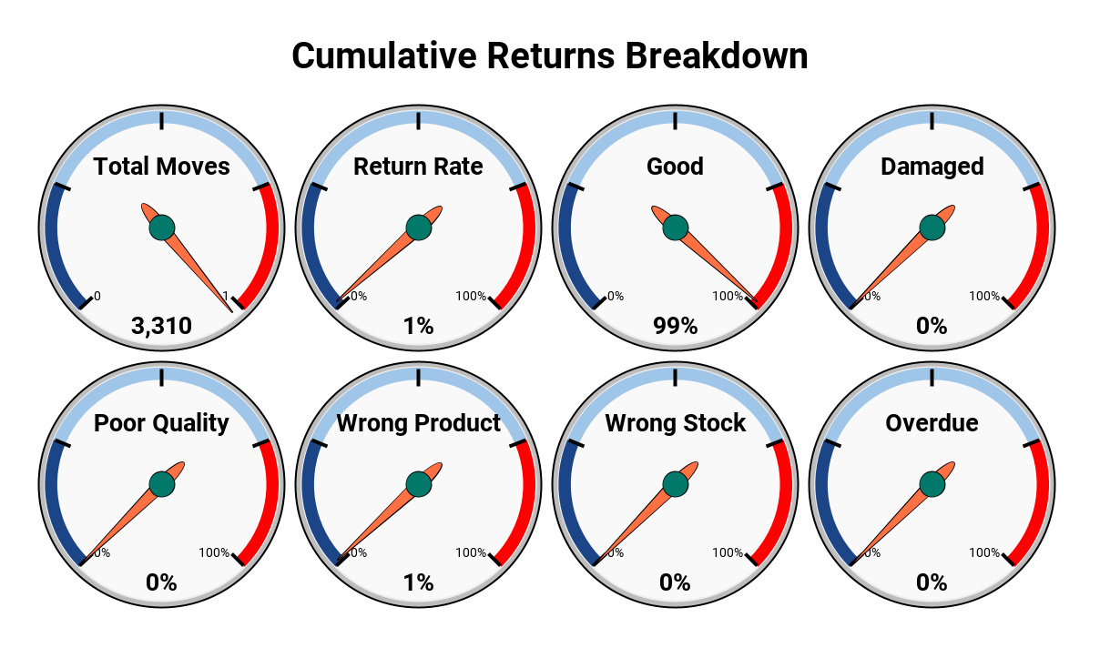
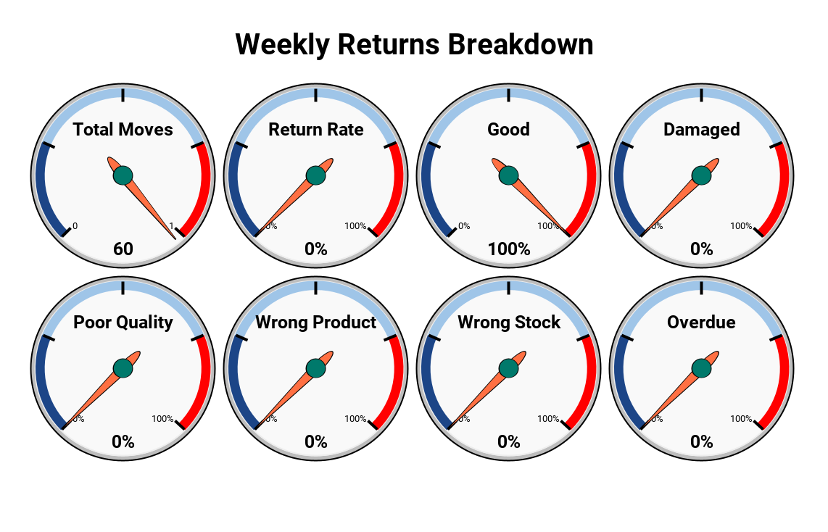
Store: Inventory ^{[13]}
Damaged | Parts issued but not used due to a physical damage
Wrong product request | This is where an end user needs spare A but requests for spare B
Wrong stock picking | Parts issued by stores does not match parts requested
Poor quality | Parts issued but not used due to bad quality
Overdue | Delayed parts issuance making the end user to explore other solutions

Slide 15

Thank you

